Slide 1
North American EMT Modeling Challenges and Opportunities
EMT Webinar Series
Aung Thant
Principal Engineer
March 10, 2026

Slide 2
NERC-Industry Collaboration
Long-term
Medium
Short
NERC EMTWG
EMT Modeling Working Group
Best Practices
Guidelines
ORNL-DOE-NERC- Industry
Efficiency
Accuracy
Expertise
Outreach

Slide 3
NERC EMT Modeling Working Group (EMTWG)
Support industry adoption of EMT Modeling
Repository of resources – reading list, tutorials, technical presentations
Recent work:
  White Paper: EMT Modeling Adoption for Interconnection and Planning Studies – Industry Survey
  White Paper: EMT Analysis in Operations
On-going work:
  Benchmarking IBR Aggregate Plant Models
  Uniform IBR Plant Model and Testing
  Model portability and interoperability
  EMT Modeling Consideration to Study Large Load Impact on BPS Reliability

Slide 4
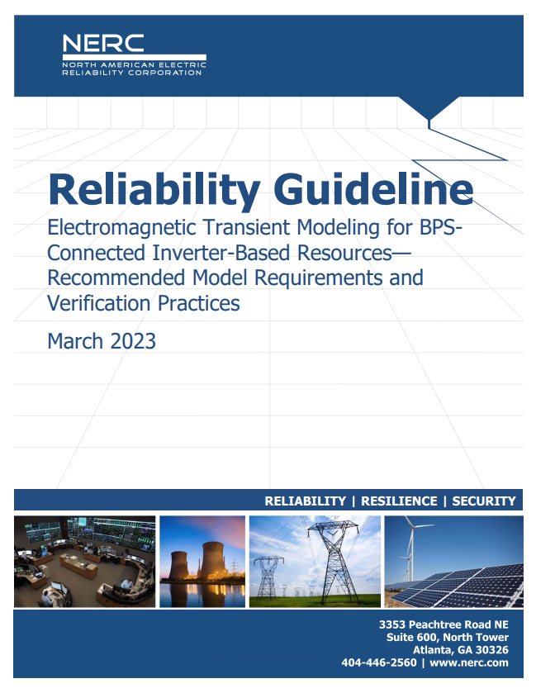
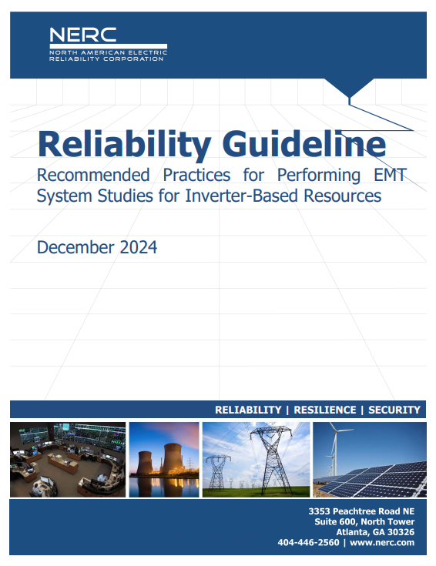
Reliability Guidelines on EMT Modeling

Slide 5

Staged Approach to EMT Modeling Adoption
Stage 1
Stage 2
Stage 3
Stage 4
Stage 5
EMT Model Quality Verification
Plant Performance Assessment & Model Benchmarking
Screening and Integration in Interconnection Process
Conducting Interconnection and Planning Studies
Establishing EMT Model Requirements
1st Guideline Scope
2nd Guideline Scope

Slide 6

Draft Large Load Reliability Guideline
Screening Criteria for EMT study
Large Load Dynamic Models
Model verification report requirements
Model quality requirements
Post-event data sharing and model validation
Model update process

Slide 7
EMT Adoption Survey Summary
Challenges
Expertise and Resource Constraints
Near-term Action
Broaden Training and Resources
Long-term Action
Optimize Compatibility Standards
Complexity of Models and Large System Studies
Keeping up with Technological Changes
Model Data Sharing
Standardization of EMT Modeling Practices
Investment in Simulation Tools and Infrastructure
Early Model Verification and Coordination
Adaptability
Leverage High-Performance Computing (HPC) Solutions
Advance Automation and Interoperability
Improve Data Sharing

Slide 8
Progress
1st EMT Workshop
2nd EMT Workshop
3rd EMT Workshop
4th EMT Workshop
2023
2024
2025
2026
EMT Activities
NERC EMTWG EMT Adoption Survey

Slide 9
Effective and Efficient EMT Modeling Framework
scalability
interoperability
flexibility
efficiency
enterprise-ready

